Slide 1


Slide 2

MEDRECYCLE
Muhammad Hassan Khalid (21L-5692)
Muhammad Hamza (21L-5636)
Nimra Amer (21L-5609)
Muhammad Ahmad (21L-5617)

Slide 3
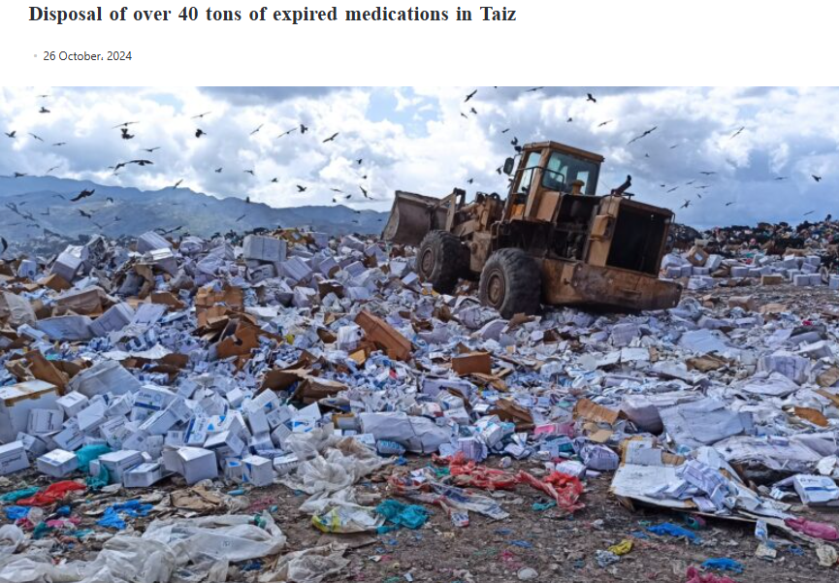
Notes:
https://www.yemenmonitor.com/en/Details/ArtMID/908/ArticleID/125327

Slide 4
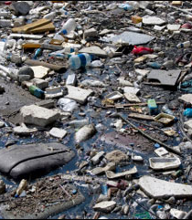
The Problem & Opportunity
Environmental Hazard: Millions of tonnes of expired medicines enter landfills or waterways each year
Regulatory Burden: Hospitals and pharma industries face costly disposal requirements
Market Demand: Growing consumer and institutional appetite for sustainable solutions

Slide 5
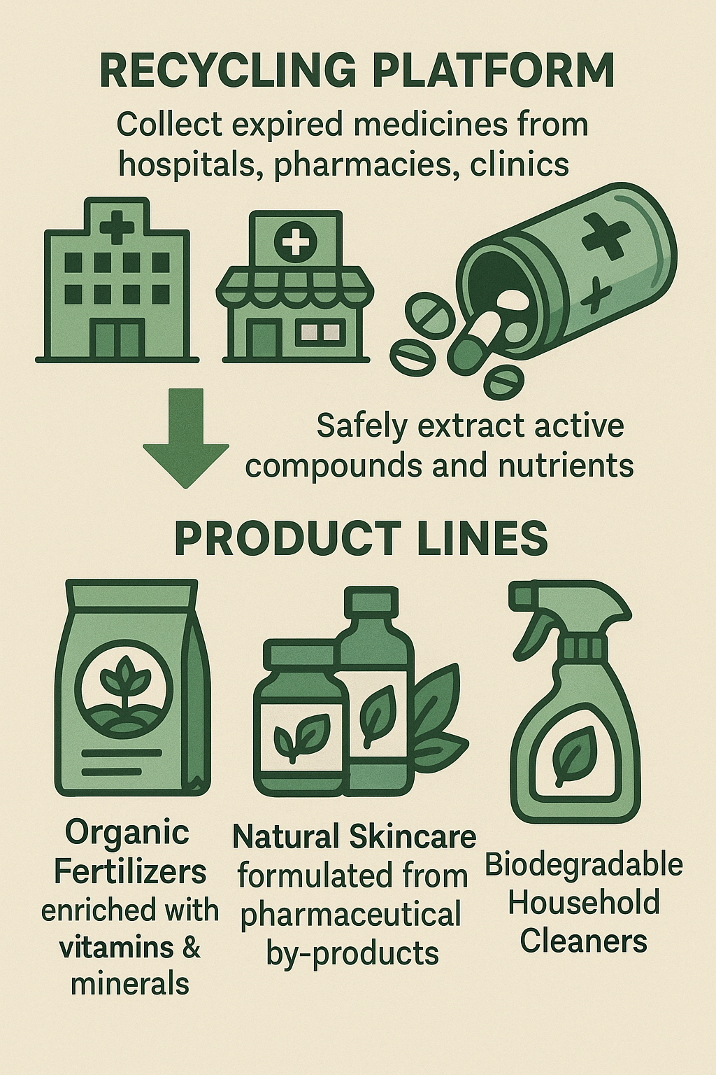
Our Solution

Slide 6
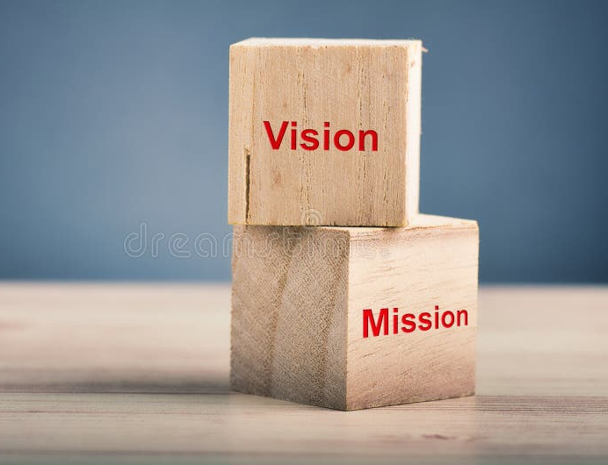
Company Overview
Mission Statement : To convert expired medications into beneficial and environmentally friendly items, assist in minimizing pollution , and contribute to a cleaner, healthier world . Vision Statement : To become the foremost company in safe medicine recycling while developing products that safeguard the environment and enhance life for all .

Slide 7
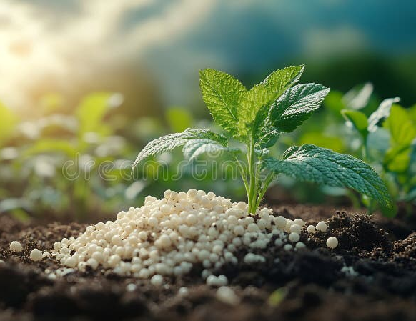

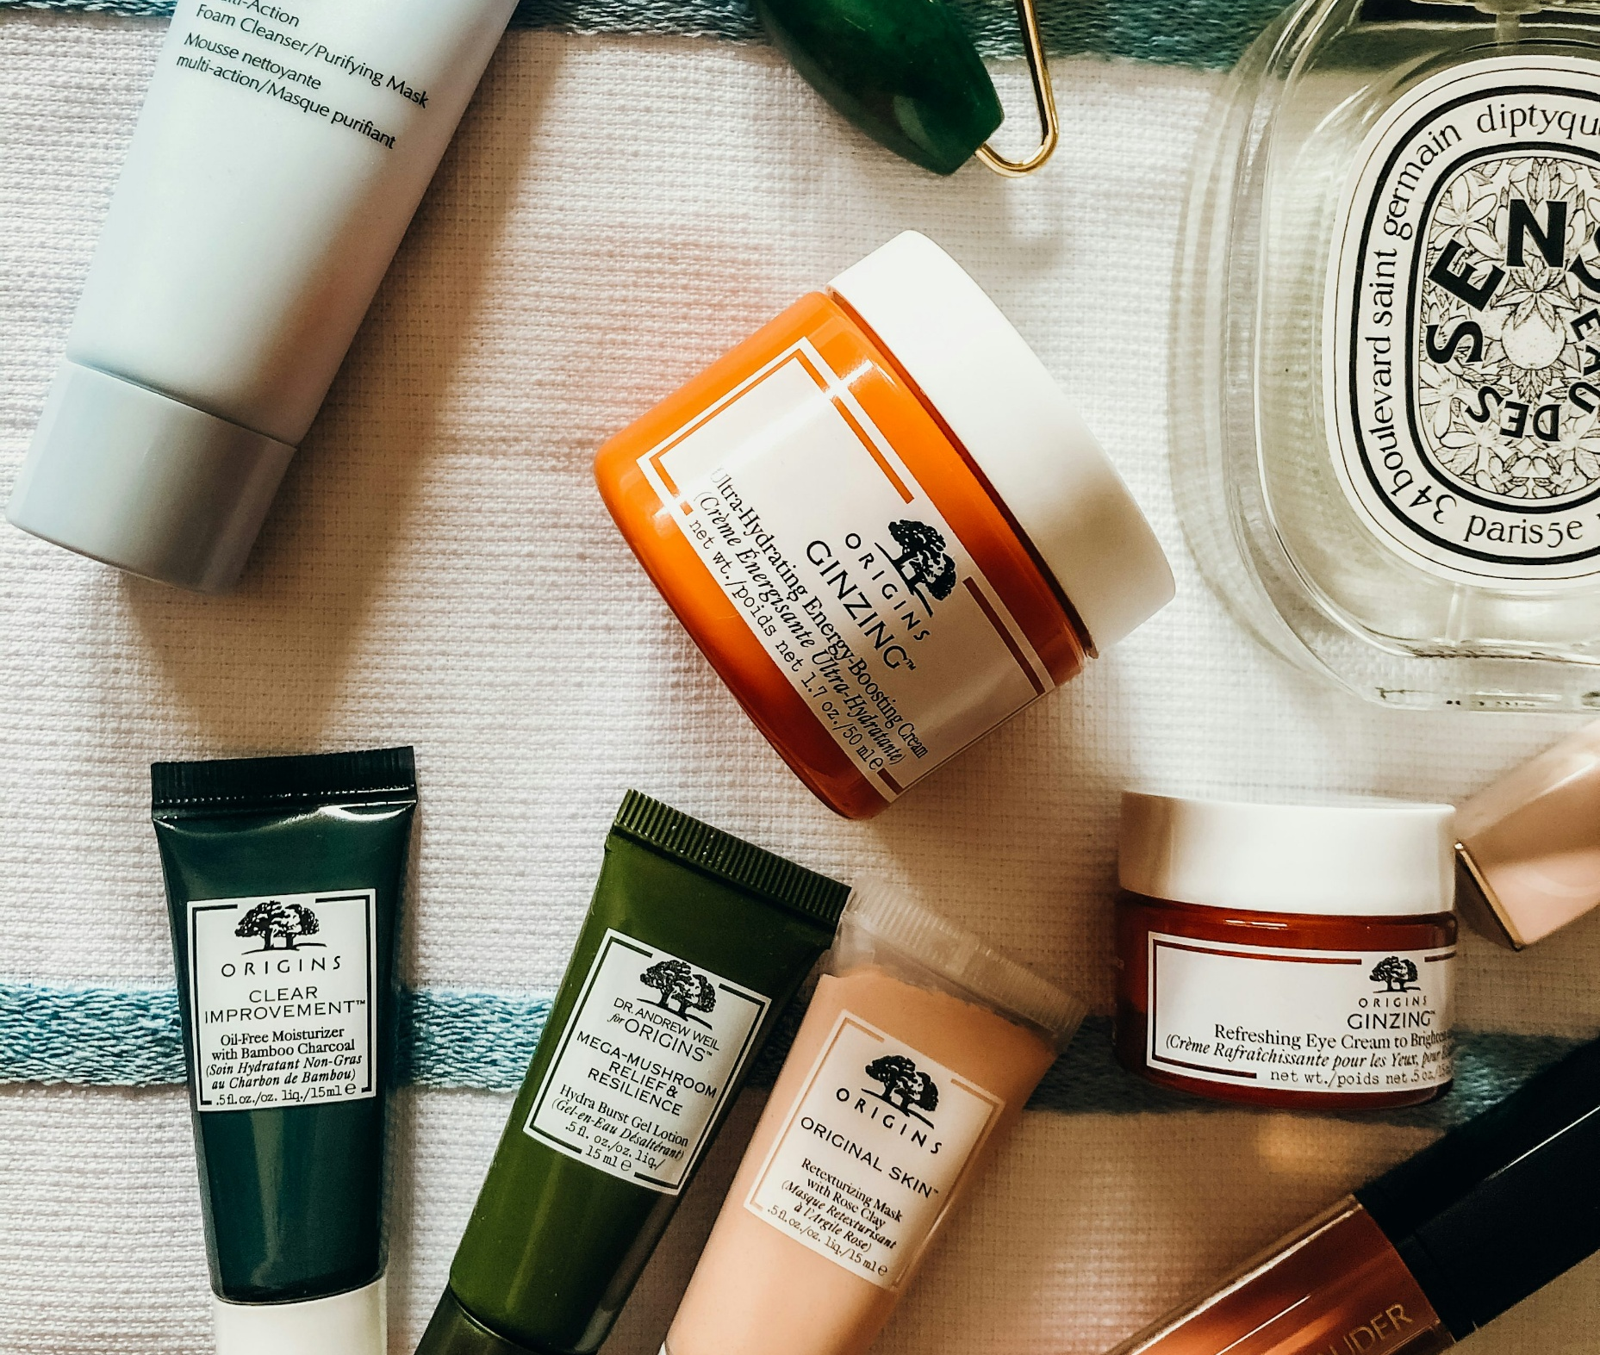
Product & Service Highlights
Eco-Fertilizers: Faster plant growth, soil health restoration
Skincare Range: Gentle, nourishing, dermatologically tested
Cleaning Solutions: Non-toxic, biodegradable, effective against pathogens
Supporting Services:
Secure collection contracts
Full QA/QC and regulatory compliance
R&D for new formulations

Slide 8
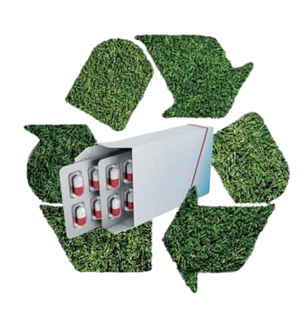
Points of Differentiation
Safe organic compounds from medicine waste.
Offering products, all made from pharmaceutical resources.
Significantly reduced production costs by sourcing raw materials from expired medicines, allowing for competitive pricing and better profit margins.
Participation in pollution reduction and encouraging environmental sustainability, establishing emotional connection with environmentally conscious consumers.

Slide 9
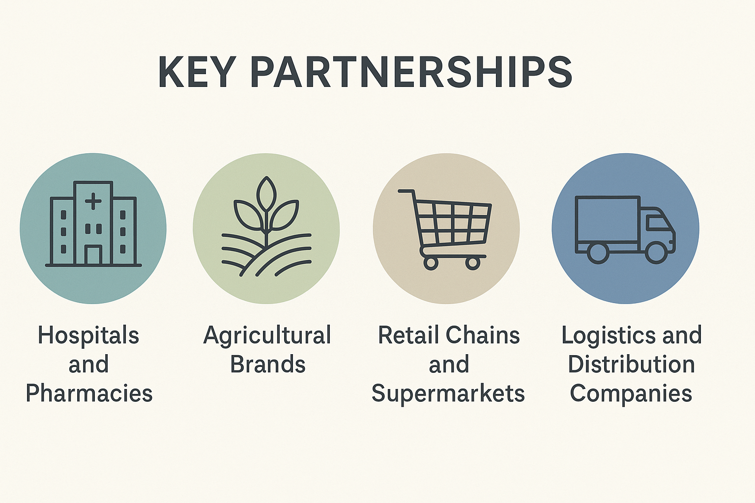

Slide 10
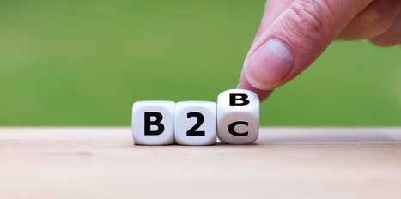


Market
Target Segments:
B2B: Hospitals, pharma industries, agricultural wholesalers
B2C: Eco-conscious consumers, home gardeners, beauty buyers
Market Size & Growth:
Global green-products market growing 10–12% p.a.
Pakistan moving toward stricter pharma-waste rules
Competitive Edge:
Proprietary extraction technology
First-mover in Pakistan combining waste-management fees with product sales

Slide 11
Industry Analysis
MedRecycle operates in a regulated and emerging industry.
High potential due to sustainability trends and waste management needs.
Barriers to Entry
Supplier & Consumer Power
Challenges:
Regulatory compliance
High startup capital
Need for technology and expertise
MedRecycle’s Response:
Strategic partnerships
Financial planning
Tech innovation and skilled staff
Supplier Challenge:
Limited sources of pharma waste
Response:
Diverse contracts with pharma industries and hospitals
Long-term agreements
Consumer Challenge:
Demand for quality, price, and green value
Response:
Unique eco-products
Brand loyalty strategy

Slide 12
Industry Analysis
MedRecycle operates in a regulated and emerging industry.
High potential due to sustainability trends and waste management needs.
Substitutes & Competitors
Challenges & Competitive Edge
Substitute Threats:
Incineration, landfill, plant-based alternatives
Response:
Proprietary recycling tech
Broad green product line
Rivalry:
Moderate competition
Response:
Brand differentiation
Strategic alliances
Startup Challenges:
Complex licensing
High investment
Awareness gap
Solutions:
Legal experts and grants
Sustainable investors
Education campaigns
Competitive Advantage:
First-mover
Innovative method to produce products
Strong partnerships

Slide 13

Competitor Analysis
Direct Competitors
Companies producing similar end-products:
Engro Fertilizers – chemical fertilizers
Marhaba Laboratories – herbal cosmetics
Pak Organics – organic cleaning and personal care products
Indirect Competitors
Companies offering waste disposal without recycling:
Pak Chem – pharma waste destruction
WMS Pakistan – traditional waste disposal services

Slide 14
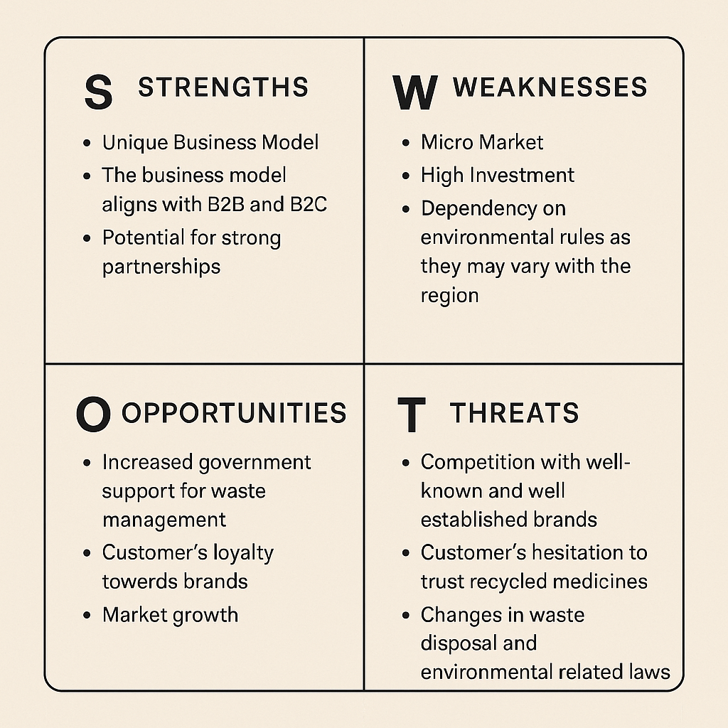

Slide 15
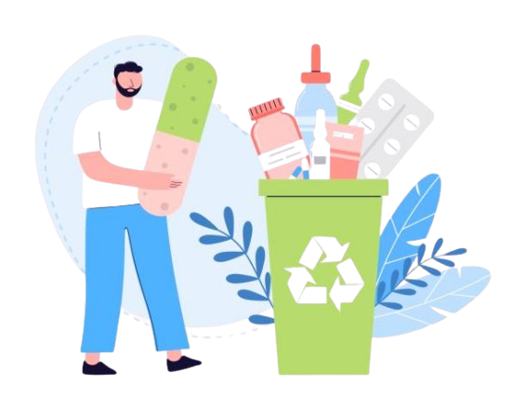
Marketing Plan
Product
Range: Skincare, fertilizers, household cleaning products
Features: Organic, safe, tested for effectiveness
Quality: High-performance from natural ingredients
Design: Biodegradable, minimal plastic, recyclable packaging
After-Sales: Customer support, refill programs
Brand Focus: Sustainability, innovation, eco-consciousness

Slide 16
Marketing Plan
Price
Strategy:
Penetration pricing (initially low to gain traction)
Value-based pricing (based on consumer-perceived eco-value)
Discounts:
Seasonal (Earth Day, Awareness Months)
Bulk orders for hospitals/pharmacies
Profit Margin:
Fertilizers: 30–40%
Skincare/Cleaners: 25–35%

Slide 17
Marketing Plan
Place
Market: B2B (hospitals, clinics, pharma industries), B2C (consumers)
Distribution Channels:
E-commerce platforms (direct-to-consumer)
Retail partnerships (agricultural, cosmetic and departmental stores)
Waste management services for hospitals/pharma industries

Slide 18
Marketing Plan
Promotion
Advertising: Targeted social media, educational content
Publicity: Media features, partnerships with NGOs
Direct Marketing: Email campaigns, cold calls to healthcare institutions

Slide 19



Go-to-Market & Marketing
Channels:
Direct B2B sales team outreach & trade shows
E-commerce platform for B2C orders
Partnerships with agri-stores, cosmetic retailers
Promotional Tactics:
Digital campaigns (social media, SEO, email)
“Green Partner” referral incentives
Educational content & webinars

Slide 20
Regulatory Approvals
Compliance with:
Pakistan Environmental Protection Agency (Pak-EPA)
Drug Regulatory Authority of Pakistan (DRAP)
Environmental Protection Departments (EPDs) at the provincial level
Required inspections, testing, and audits may cause delays
Product Effectiveness & Safety Testing
Requires laboratory and field testing
Certifications needed from:
Pakistan Council of Scientific and Industrial Research (PCSIR)
Pakistan Standards and Quality Control Authority (PSQCA)
Challenges & Risks

Slide 21
Supply Chain Challenges
Must build partnerships with hospitals and pharma industries for legal collection
Compliance with Hospital Waste Management Rules 2005 is mandatory
Public Perception & Awareness
Need strong marketing efforts
Must educate public and businesses on environmental and safety benefits
Intellectual Property Protection
Protect recycling methods and product designs via:
Intellectual Property Organization of Pakistan (IPO Pakistan)
Challenges & Risks

Slide 22
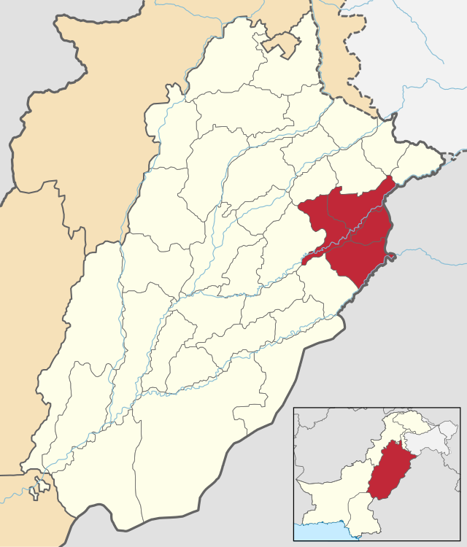
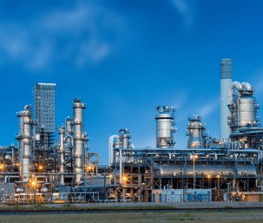

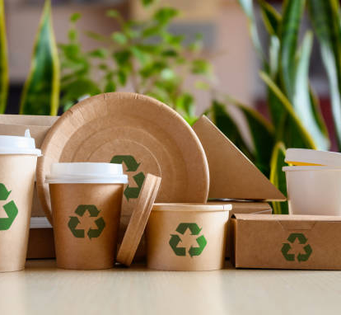
Operations & Infrastructure
Location: Industrial zone, Lahore
Facilities:
Recycling & processing plant
In-house R&D lab for testing & new products
Eco-packaging unit
Offices for Operations and Marketing
Systems & Compliance:
ERP/CRM for supply-chain and customer management
Ongoing audits to meet DRAP, Pak-EPA, PSQCA standards

Slide 23
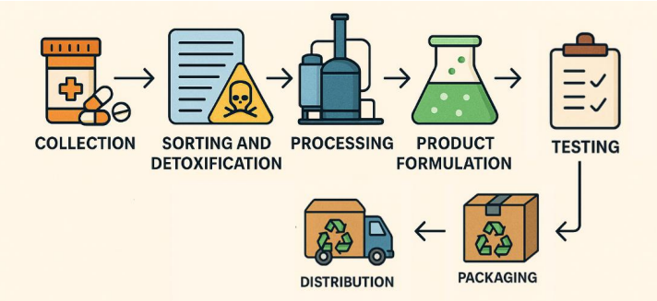

Slide 24
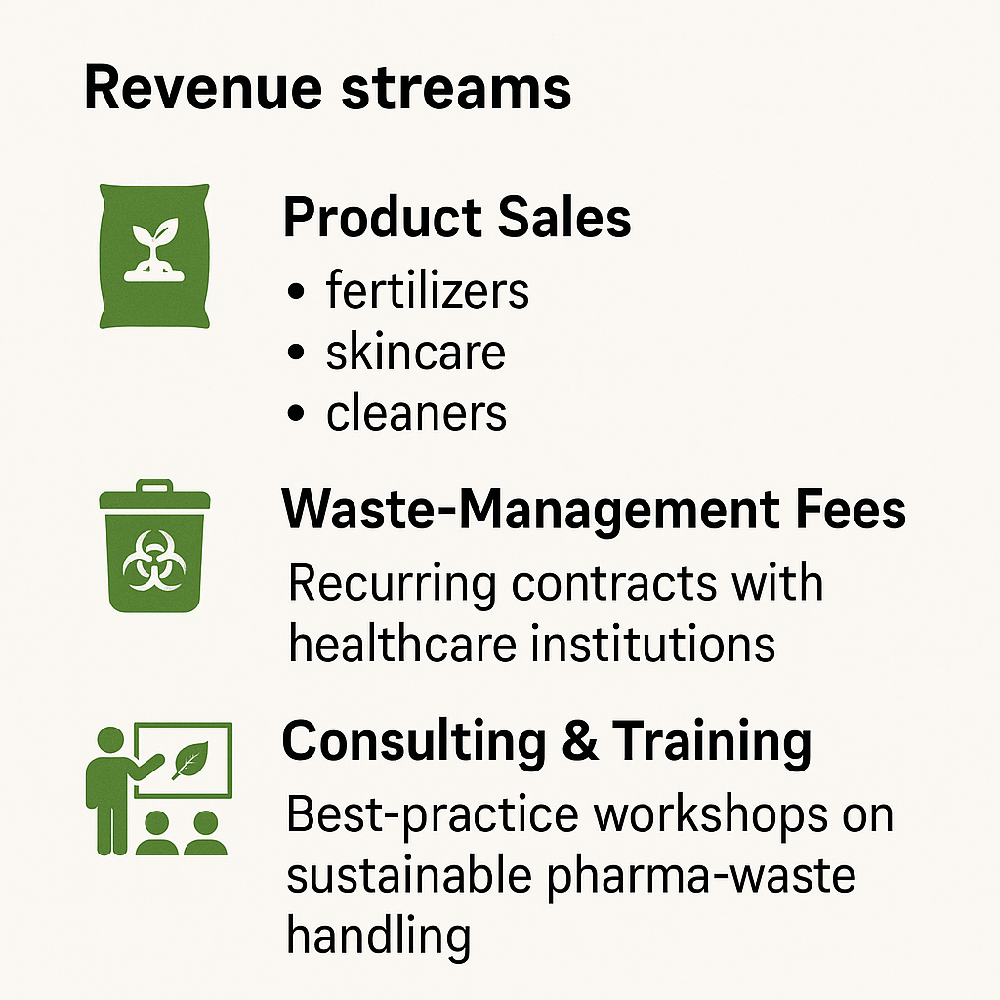
Business Model & Revenue Streams

Slide 25
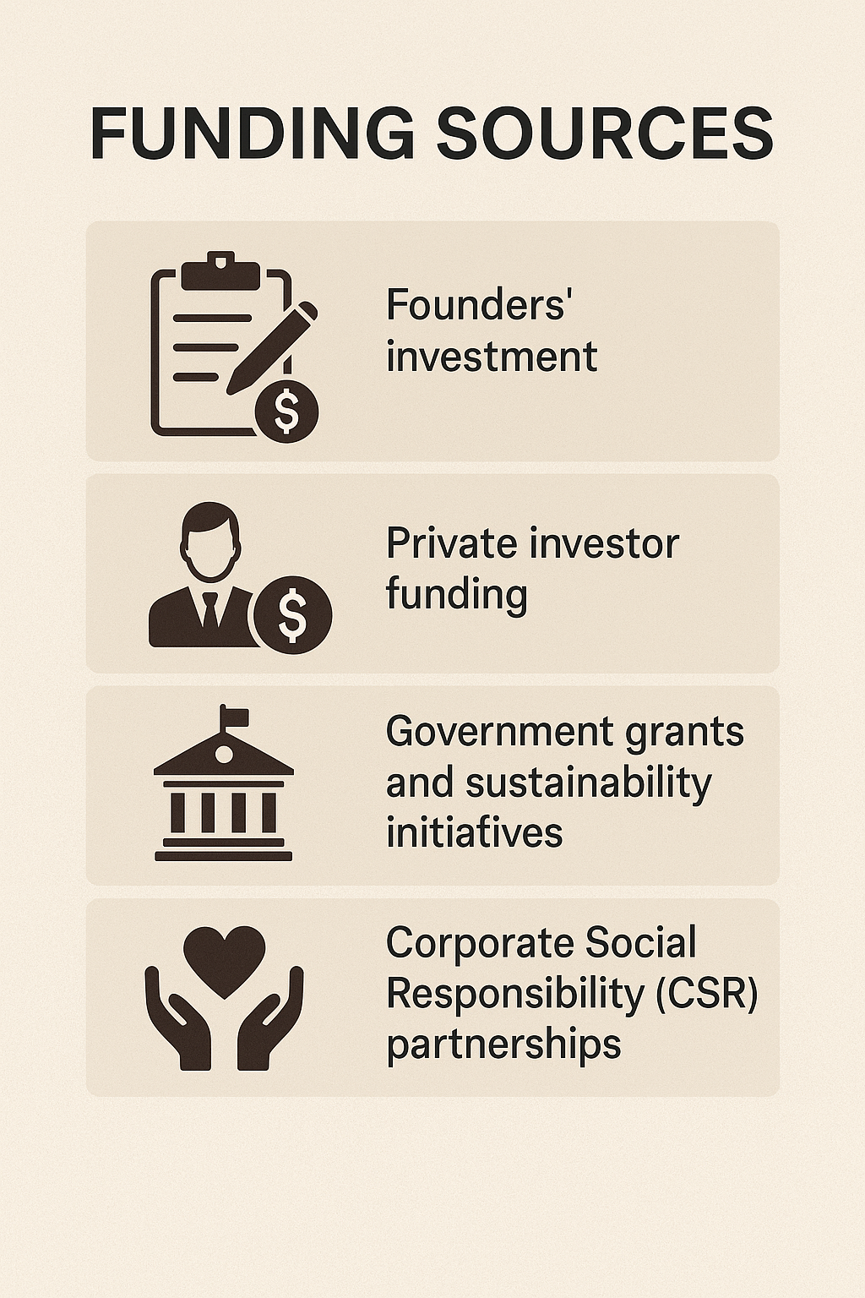

Slide 26
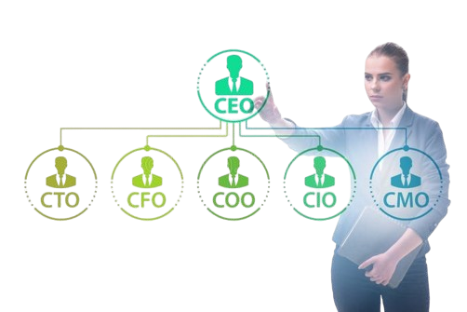
Team & Governance
Leadership:
CEO: Nimra Amer – Strategy & R&D
COO: Muhammad Ahmad – Operations & Logistics
CFO: Muhammad Hamza – Finance & Funding
CMO: Muhammad Hassan – Marketing & Sales
Advisors & Partners:
Environmental regulators, university researchers, logistics providers

Slide 27
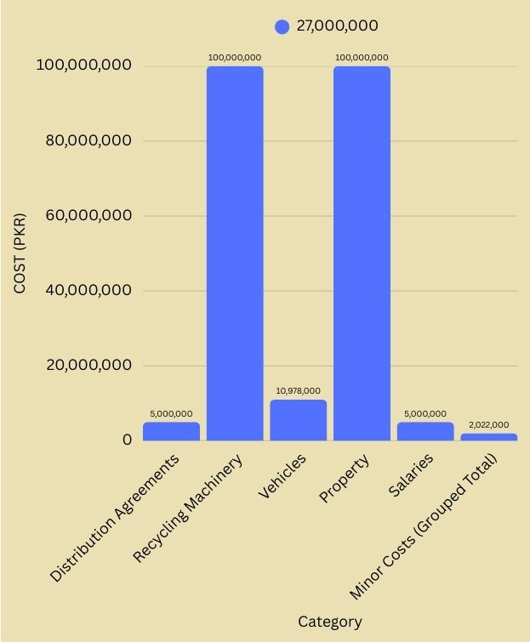
Asset / Expense | Amount (PKR)
Cash and Cash Equivalents | 27,000,000
Distribution Agreements | 5,000,000
Recycling Machinery | 100,000,000
Vehicles | 10,978,000
Property | 100,000,000
Salaries | 5,000,000
Minor Costs (Grouped Total) | 2,022,000
Furniture and Fixtures | 500,000
R&D Lab Equipment | 300,000
Licenses | 300,000
Trademarks | 20,000
Website and Digital Assets | 50,000
Safety Testing Equipment | 30,000
Eco-friendly Packaging Inventory | 22,000
Spare Parts Inventory | 500,000

Slide 28
Key Metrics
Product | Units Sold/Year | Price/Unit (PKR) | Annual Revenue (PKR)
Fertilizer (10 kg bags) | 11,450 | 500 | 5,725,000
Skincare products (bottles) | 7,857 | 700 | 5,499,900
Cleaning agents (1L bottles) | 9,437 | 400 | 3,774,800
Total Product Sales | — | — | 15,000,000
🏥 Expired Medicine Waste Management Services
100 hospitals/pharma industries
Each paying PKR 50,000/year
Service Revenue = 100 × 50,000 = 5,000,000 PKR

Slide 29
Key Metrics
Year | Annual Revenue (PKR) | Cumulative Revenue (PKR)
Year 1 | 20,000,000 | 20,000,000
Year 2 | 20,000,000 × 1.20 = 24,000,000 | 20,000,000 + 24,000,000 = 44,000,000
Year 3 | 24,000,000 × 1.20 = 28,800,000 | 44,000,000 + 28,800,000 = 72,800,000
Year 4 | 28,800,000 × 1.20 = 34,560,000 | 72,800,000 + 34,560,000 = 107,360,000
Year 5 | 34,560,000 × 1.20 = 41,472,000 | 107,360,000 + 41,472,000 = 148,832,000
Year 6 | 41,472,000 × 1.20 = 49,766,400 | 148,832,000 + 49,766,400 = 198,598,400
Year 7 | 49,766,400 × 1.20 = 59,719,680 | 198,598,400 + 59,719,680 = 258,318,080

Slide 30
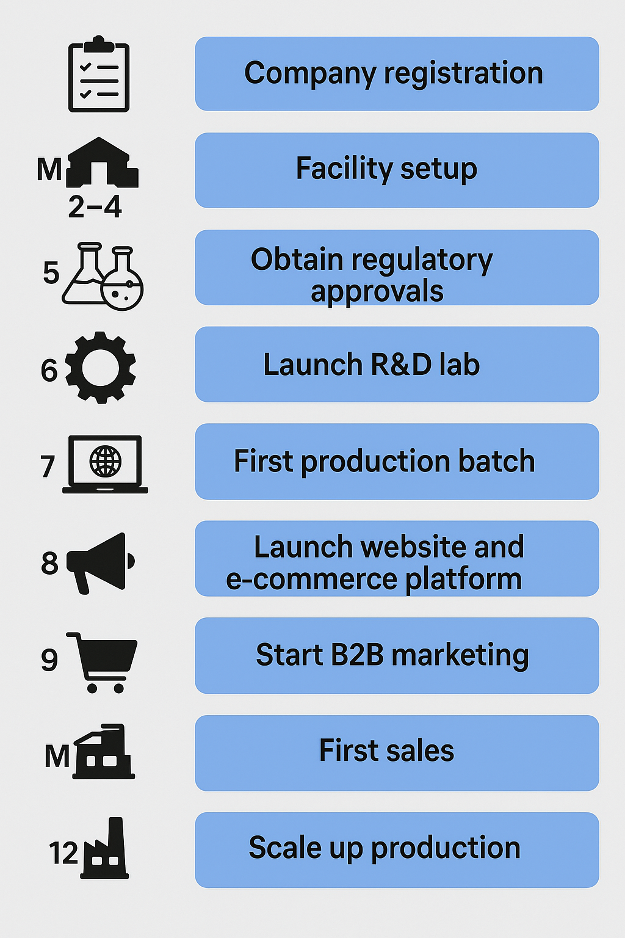
ROADMAP

Slide 31
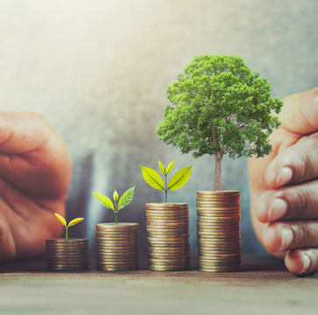
Call to Action
Investment Opportunity: Join us in creating Pakistan’s first pharmaceutical-waste circular economy
Partnerships Wanted: Healthcare institutions, agriculture partners, sustainability advocates

Slide 32


